Slide 1
Single–axis Accelerometer Performance TIA Optimization
ICS905
High performance Sensors & Transducers (HiPStr)
Presented by
Maxwell McFarlane & Mohammad Abdelnaby
Supervised by Prof. Jérôme Juillard

Slide 2
Agenda
01
02
03
04
TIA Stage Expectations
TIA Stage LTSpice Simulations
Top Level
05
06
TIA Performance
Post-TIA Process
Conclusion

Slide 3
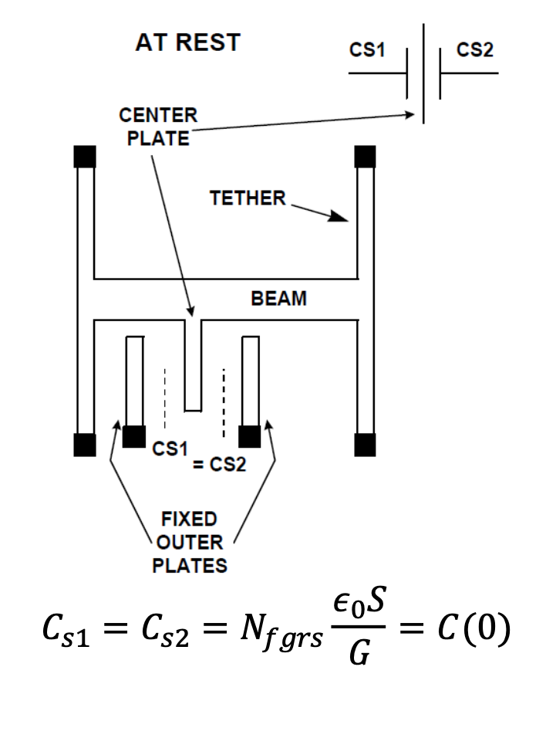
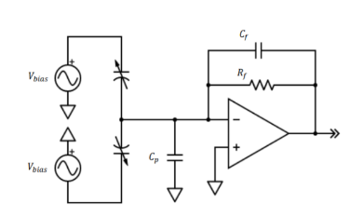
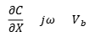
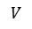
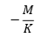
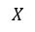
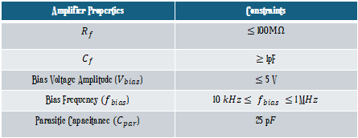
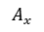
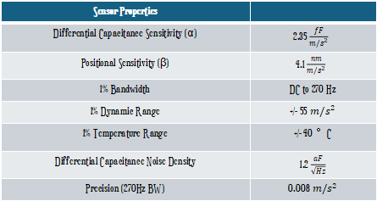
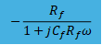
Top Level - Design Model
$$X$$
$$I$$
$$V$$
$$A_{x}$$
$$−\frac{M}{K}$$
$$\frac{∂C}{∂X}×jω×V_{b}$$
$$−\frac{R_{f}}{1+jC_{f}R_{f}ω}$$
Acceleration noise
(thermal)
Current noise
(thermal, shot, flicker)
Quantizer noise
Sensor System
Electrical System
Sensor Properties
Differential Capacitance Sensitivity (α) | 2.35 $\frac{fF}{m/s^{2}}$
Positional Sensitivity (β) | 4.1 $\frac{nm}{m/s^{2}}$
1% Bandwidth | DC to 270 Hz
1% Dynamic Range | +/- 55 $m/s^{2}$
1% Temperature Range | +/- 40 °C
Differential Capacitance Noise Density | 1.2 $\frac{aF}{\sqrt{Hz}}$
Precision (270Hz BW) | 0.008 $m/s^{2}$
Amplifier Properties | Constraints
$$R_{f}$$ | $≤$ 100$M\text{Ω}$
$$C_{f}$$ | $≥$ 1pF
Bias Voltage Amplitude ($V_{bias}$) | $≤$ 5 V
Bias Frequency $(f_{bias}$) | 10 $kHz$ $≤{ f}_{bias} ≤$ 1 M$Hz$
Parasitic Capacitance $(C_{par}$) | 25 p$F$

Slide 4
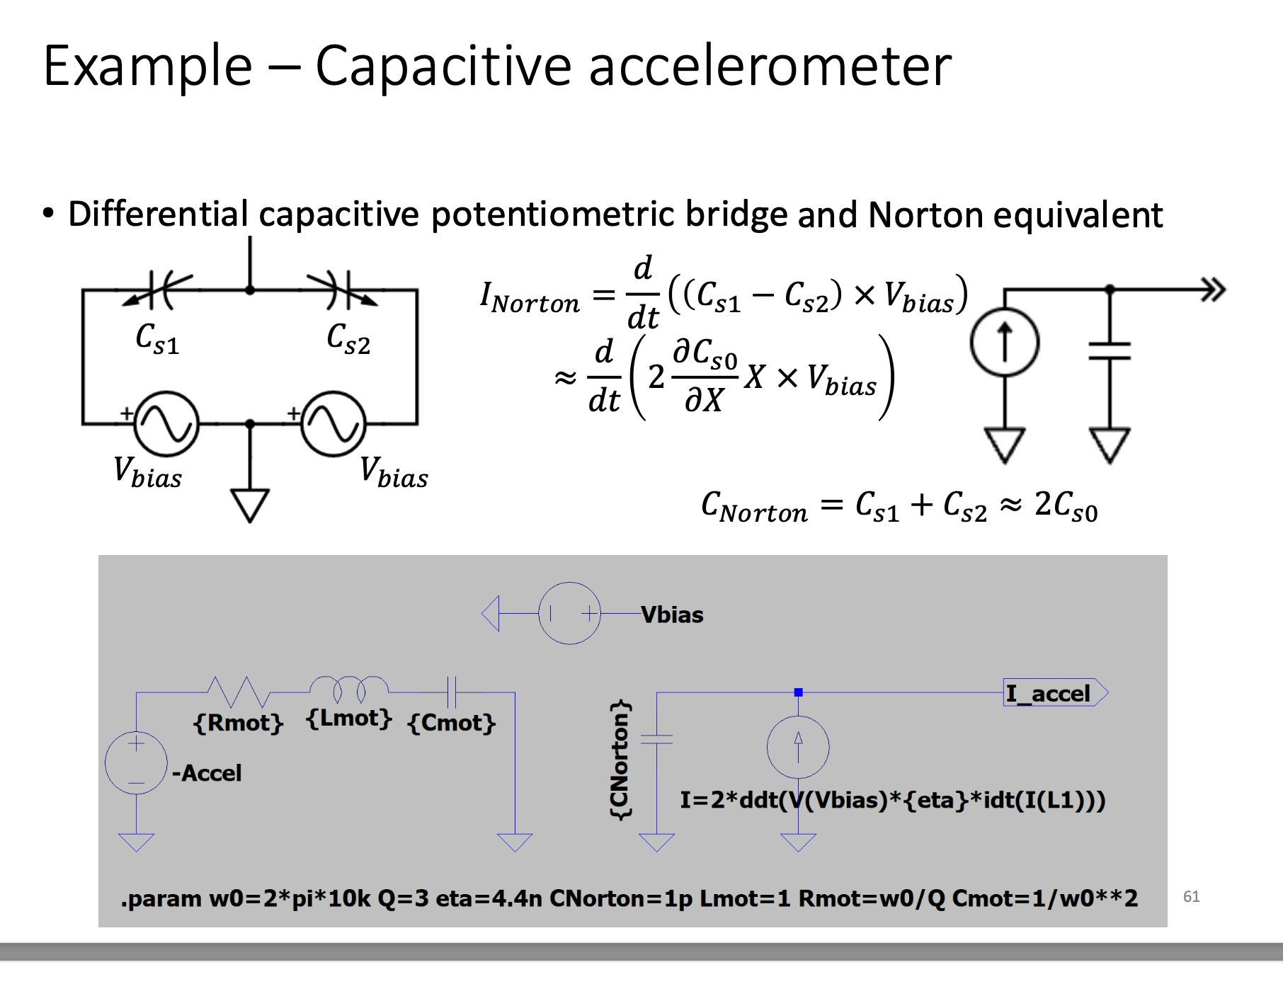
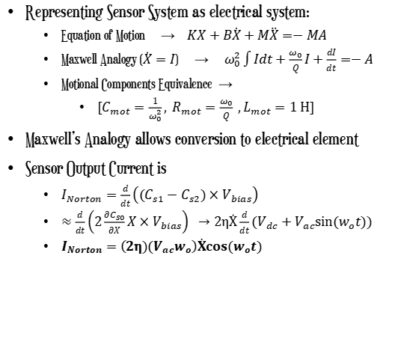
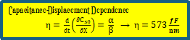
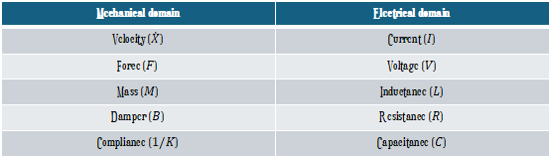
Top Level - Maxwell Analogy
Schematic Representation of Norton Model
Representing Sensor System as electrical system:
Equation of Motion → $KX+B\dot{X}+M\ddot{X}=−MA$
Maxwell Analogy ($\dot{X}=I$) → $ω_{0}^{2}\int{Idt}+\frac{ω_{0}}{Q}I+\frac{dI}{dt}=−A$
Motional Components Equivalence →
${[C}_{mot}=\frac{1}{ω_{0}^{2}}, R_{mot}=\frac{ω_{0}}{Q} ,L_{mot}=1 H]$
Maxwell’s Analogy allows conversion to electrical element
Sensor Output Current is
$I_{Norton}=\frac{d}{dt}\left(\left(C_{s1}−C_{s2}\right)×V_{bias}\right)$
$≈\frac{d}{dt}\left(2\frac{∂C_{s0}}{∂X}X×V_{bias}\right) →2\text{η}\dot{X}\frac{d}{dt}\left(V_{dc}+V_{ac}sin⁡(w_{o}t\right))$
$I_{Norton}=$ $\left(2\text{η}{)(V}_{ac}w_{o}\right)\dot{X}cos(w_{o}t)$
Norton Model Used for LT Simulation
Mechanical domain | Electrical domain
Velocity ($\dot{X}$) | Current ($I$)
Force ($F$) | Voltage ($V$)
Mass ($M$) | Inductance ($L$)
Damper ($B$) | Resistance ($R$)
Compliance ($1/K$) | Capacitance ($C$)
Capacitance-Displacement Dependence
$\text{η}\text{ =} \frac{d}{dt}\left(\frac{∂C_{s0}}{∂X}\right)\text{= }\frac{\text{α}}{\text{β}}$ → $\text{η}\text{ = 573}\frac{fF}{nm}$
Bias Amplitude and Frequency
are proportional to input current

Slide 5
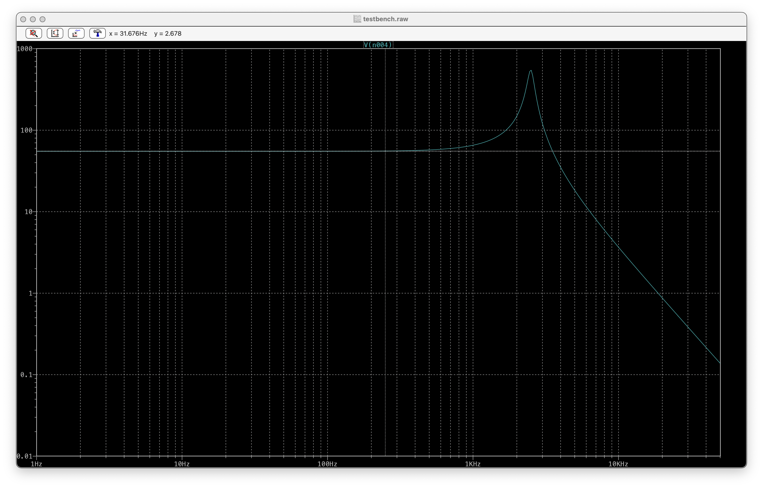
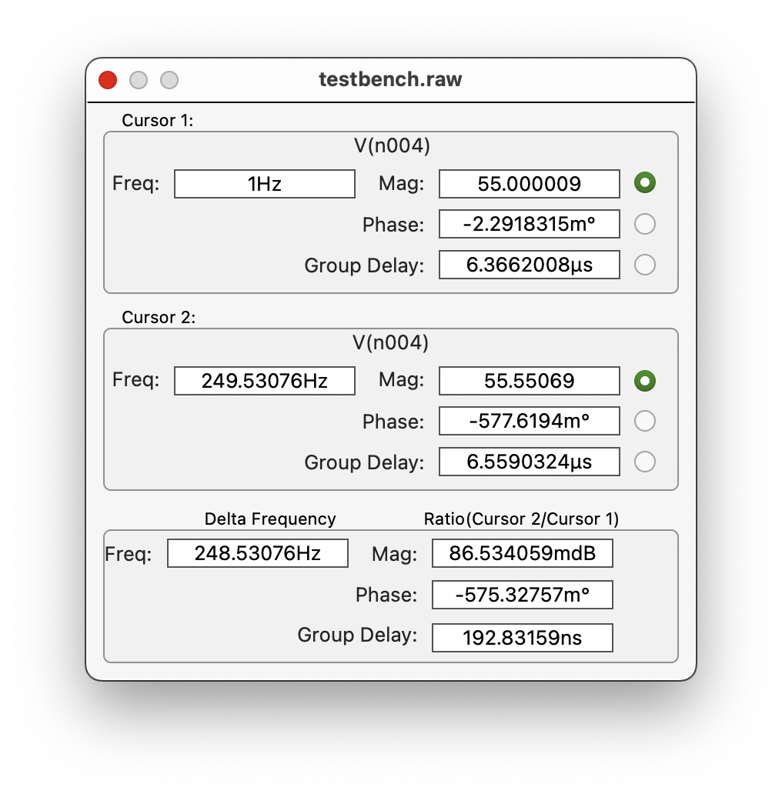
Top Level - Sensor Model LTSpice Response
Figure 1 : Gain Response of Sensor Output (Value @ 0 – 270, Compare output 1% Bandwidth [Check if Correct], …

Slide 6
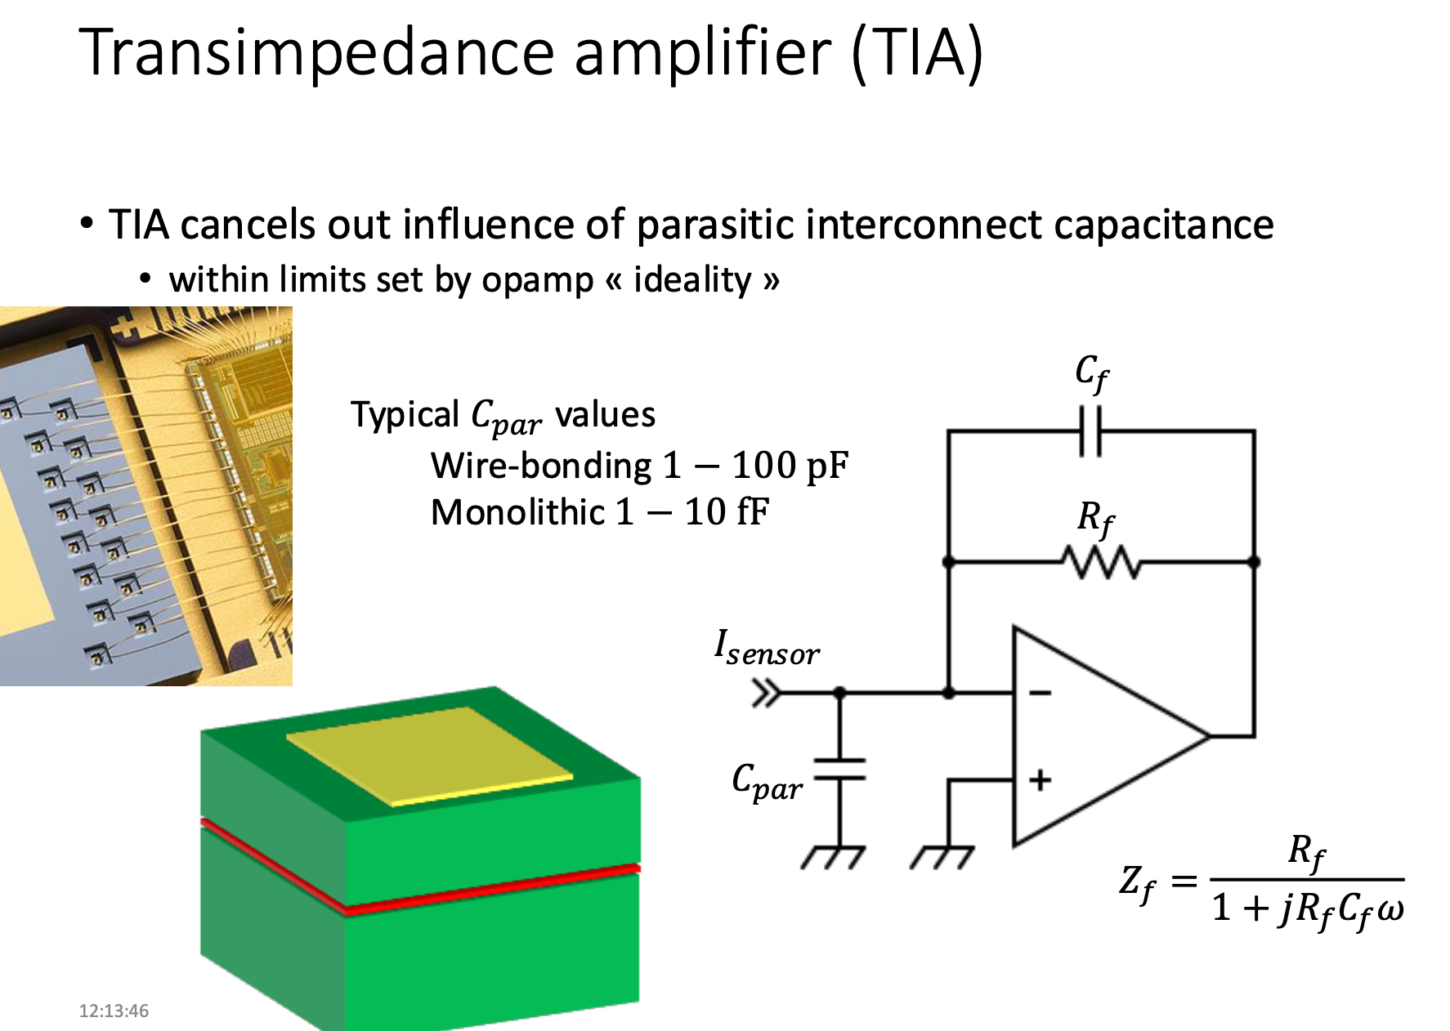
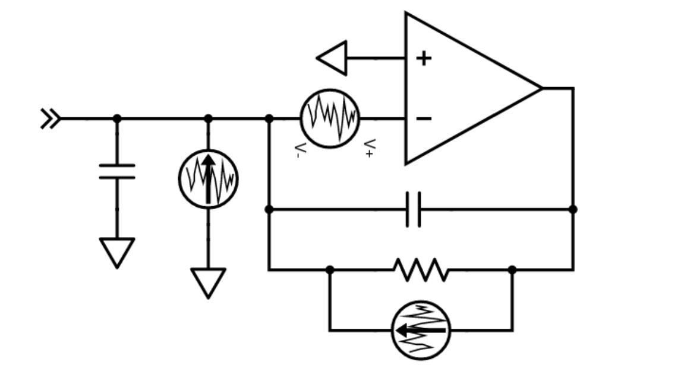
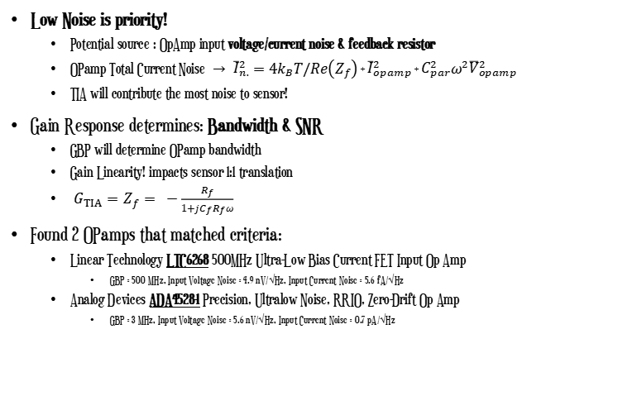
TIA Stage – Expectations/Approach
Low Noise is priority!
Potential source : OpAmp input voltage/current noise & feedback resistor
OPamp Total Current Noise$→ {\overline{I}}_{n.}^{2}=$ $4k_{B}T/Re\left(Z_{f}\right)$+ ${\overline{I}}_{opamp}^{2}$ + $C_{par}^{2}ω^{2}{\overline{V}}_{opamp}^{2}$
TIA will contribute the most noise to sensor!
Gain Response determines: Bandwidth & SNR
GBP will determine OPamp bandwidth
Gain Linearity! impacts sensor 1:1 translation
${ G}_{TIA}=Z_{f}= −\frac{R_{f}}{1+jC_{f}R_{f}ω}$
Found 2 OPamps that matched criteria:
Linear Technology LTC6268 500MHz Ultra-Low Bias Current FET Input Op Amp
GBP = 500 MHz, Input Voltage Noise = 4.9 nV/√Hz, Input Current Noise = 5.6 fA/√Hz
Analog Devices ADA4528-1 Precision, Ultralow Noise, RRIO, Zero-Drift Op Amp
GBP = 3 MHz, Input Voltage Noise = 5.6 nV/√Hz, Input Current Noise = 0.7 pA/√Hz
LTC6268 has much higher GBP and lower current noise
Expect better performance from this opamp
Quick Estimation! Since, $I_{Norton}≈\frac{d}{dt}\left(2\frac{∂C_{s0}}{∂X}X×V_{bias}\right)$
Assuming, Vbac = 5V and Vbf = 10kHz : $I_{noise}≈11.8 pA , I_{min}≈1.48 nA , I_{max}≈406 nA$
Notes:
If we consider our TIA stage as an ”LNA” amplifier for our system. We know that this amplifier has the largest impact on our noise figure until the ADC at the receiver.

Slide 7
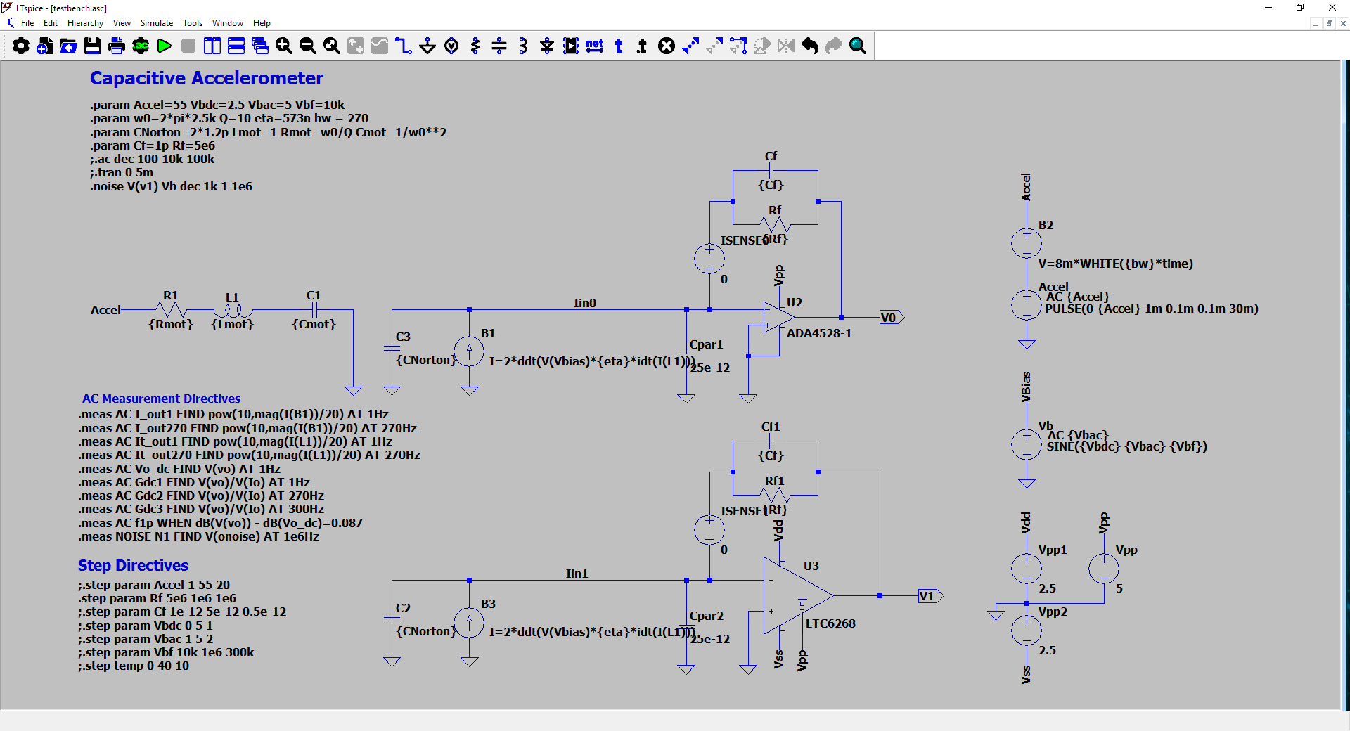
TIA Stage – LTSpice TestBench Schematic
Voltage Source used to plot
TIA current
Param. Settings
Acceleration source w/ Noise
Sensor Circuit
ADA4528-1 OPAMP
Biasing Source
Measurement
Instructions
Sweep/Step
Instructions
Supply Voltages
LTC6268 OPAMP

Slide 8
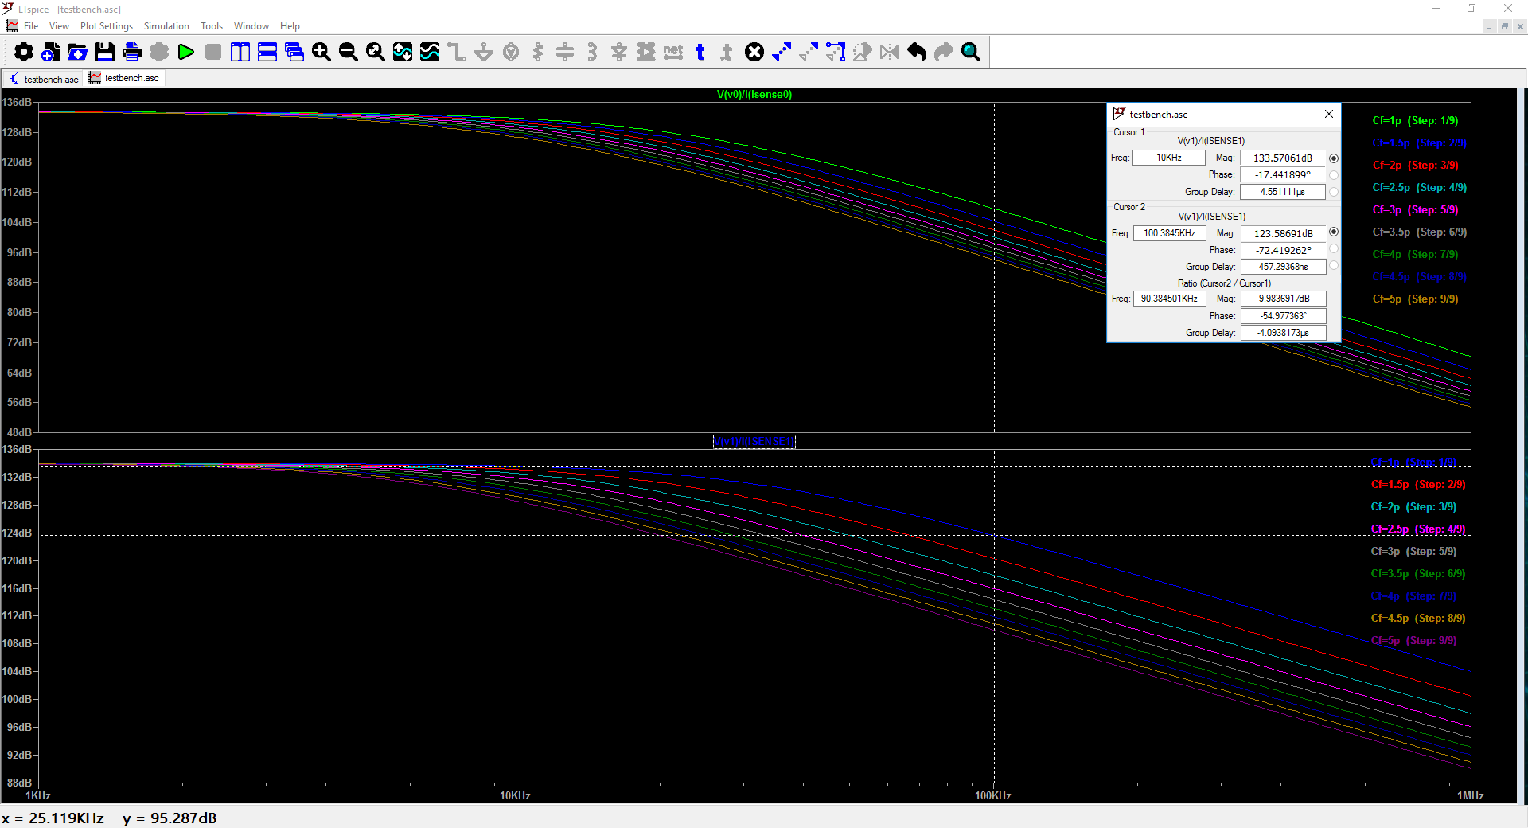
TIA Stage – LTSpice – (.ac) Gain (Cf Sweep)
As Cf increases, bandwidth is decreased. Best to choose
Cf determines linearity at our bias frequency
Gain 10dB delta over bias frequency range!

Slide 9
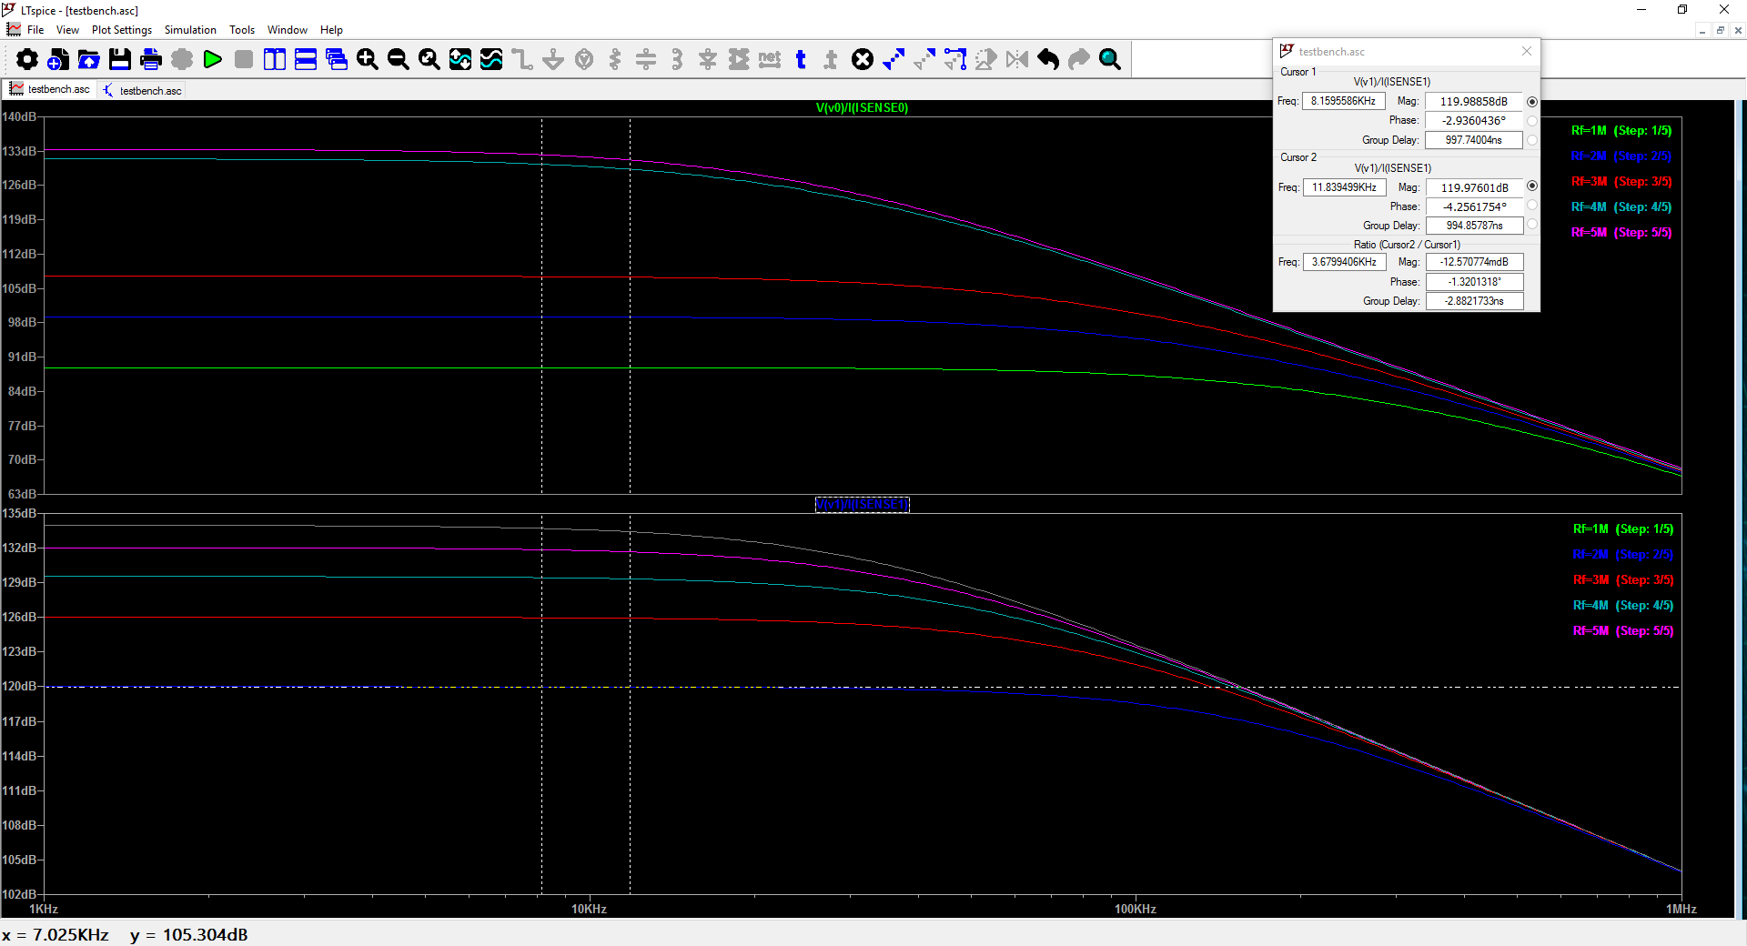
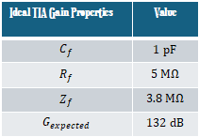
TIA Stage – LTSpice – (.ac) Gain (Rf Sweep)
As Rf increases, Gain Increases
270Hz
Ideal TIA Gain Properties | Value
$$C_{f}$$ | $$1 pF$$
$$R_{f}$$ | $$5 M\text{Ω}$$
$$Z_{f}$$ | $$3.8 M\text{Ω}$$
$$G_{expected}$$ | $$132 dB$$
Take into account linearity around center frequency!!
-12.5 mdB delta (0.14%) @ 10KHz
-381 mdB delta (4.48%) @ 100KHz
Most linear region is around bottom of bias frequency range
Notes:
We had room to choose a higher feedback resistance but in order to reduce noise at later stages during noise analysis we lowered noise as much as possible here.
For our given values we, see that staying in the 10KHz bias frequency gives us a linear output gain and a

Slide 10
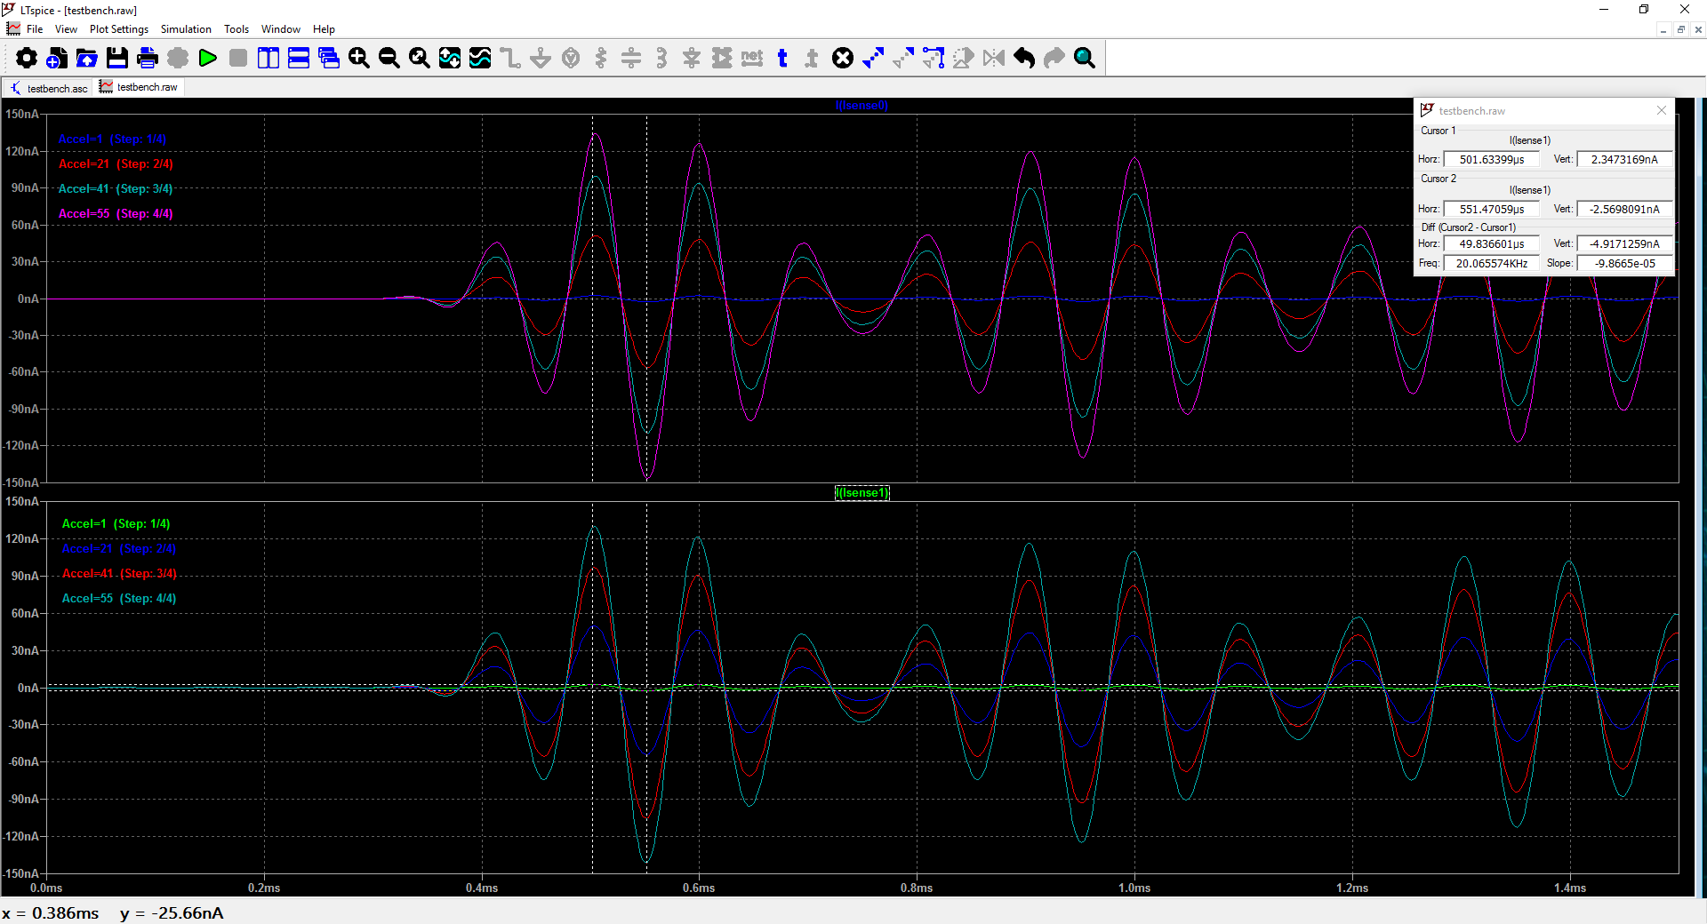
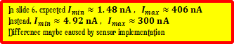
TIA Stage – LTSpice – (.trans) Accel Sweep
Sanity Check!
Acceleration translates to higher current!
In slide 6, expected $I_{min}≈1.48 nA , I_{max}≈406 nA$
Instead, $I_{min}≈4.92 nA , I_{max}≈300 nA$
Difference maybe caused by sensor implementation

Slide 11
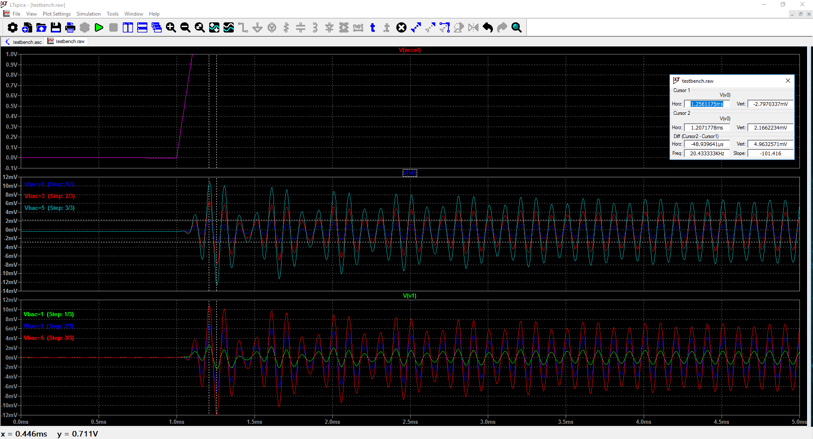
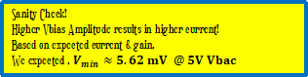
TIA Stage – LTSpice – (.trans) Vbac Sweep
Sanity Check!
Higher Vbias Amplitude results in higher current!
Based on expected current & gain,
We expected , $V_{min}≈5.62 mV @ 5V Vbac$

Slide 12
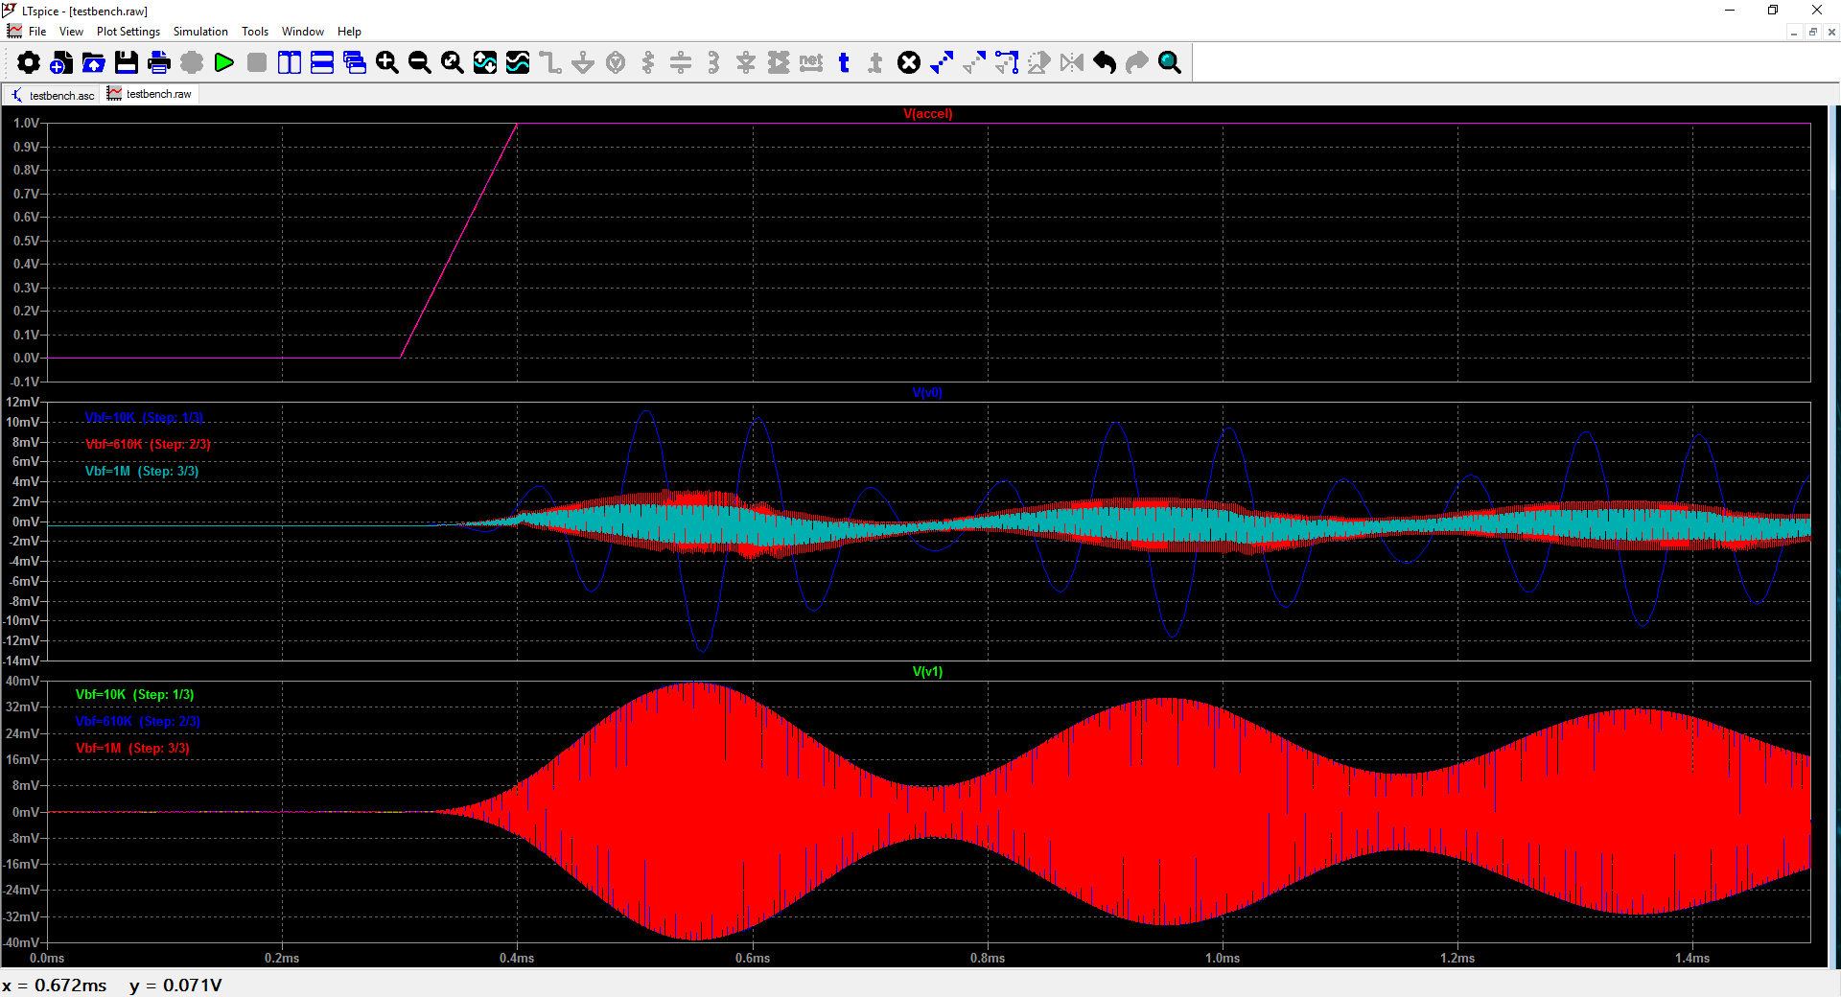
TIA Stage – LTSpice – (.trans) Vbf Sweep
Sanity Check!
Higher Vbias frequency means greater input current!
The output of the ADA4528-1 has a response inverse to expectation!
Notes:
Higher frequency kills the output voltage/current.
Could likely contribute this to the GBP being near 3M where the LTC6268 has a GBP of 50M
Or Seeing a change in comparison between gains between op amps in transient sims. Consider this is probably do to input capacitances that are a 10x difference

Slide 13
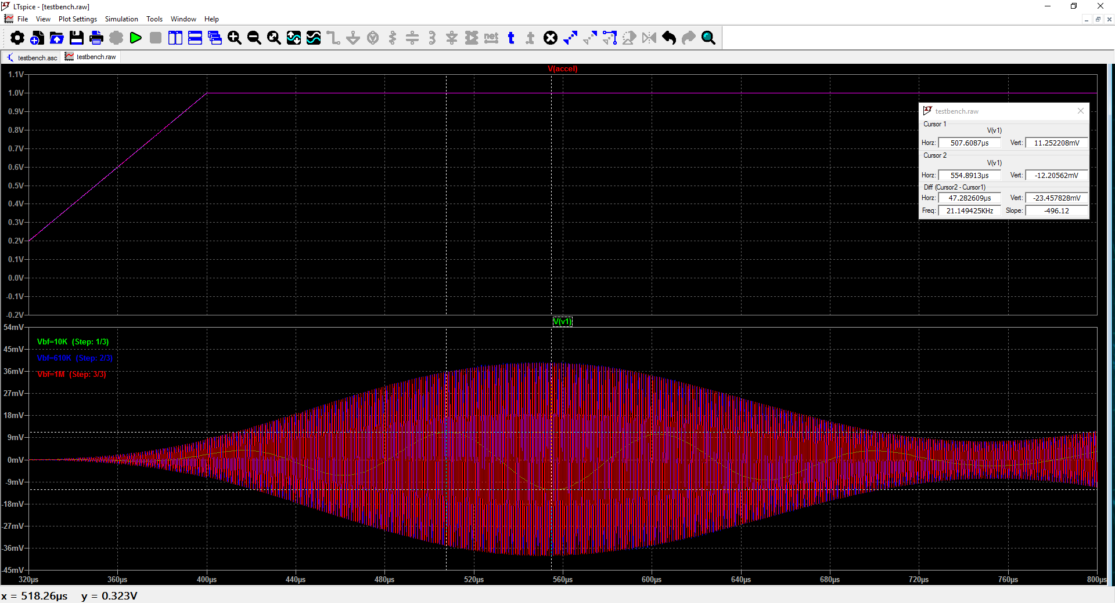
TIA Stage – LTSpice – (.trans)Vbf Sweep
A clearer view that the higher bias frequency
is proportional to higher output current.

Slide 14
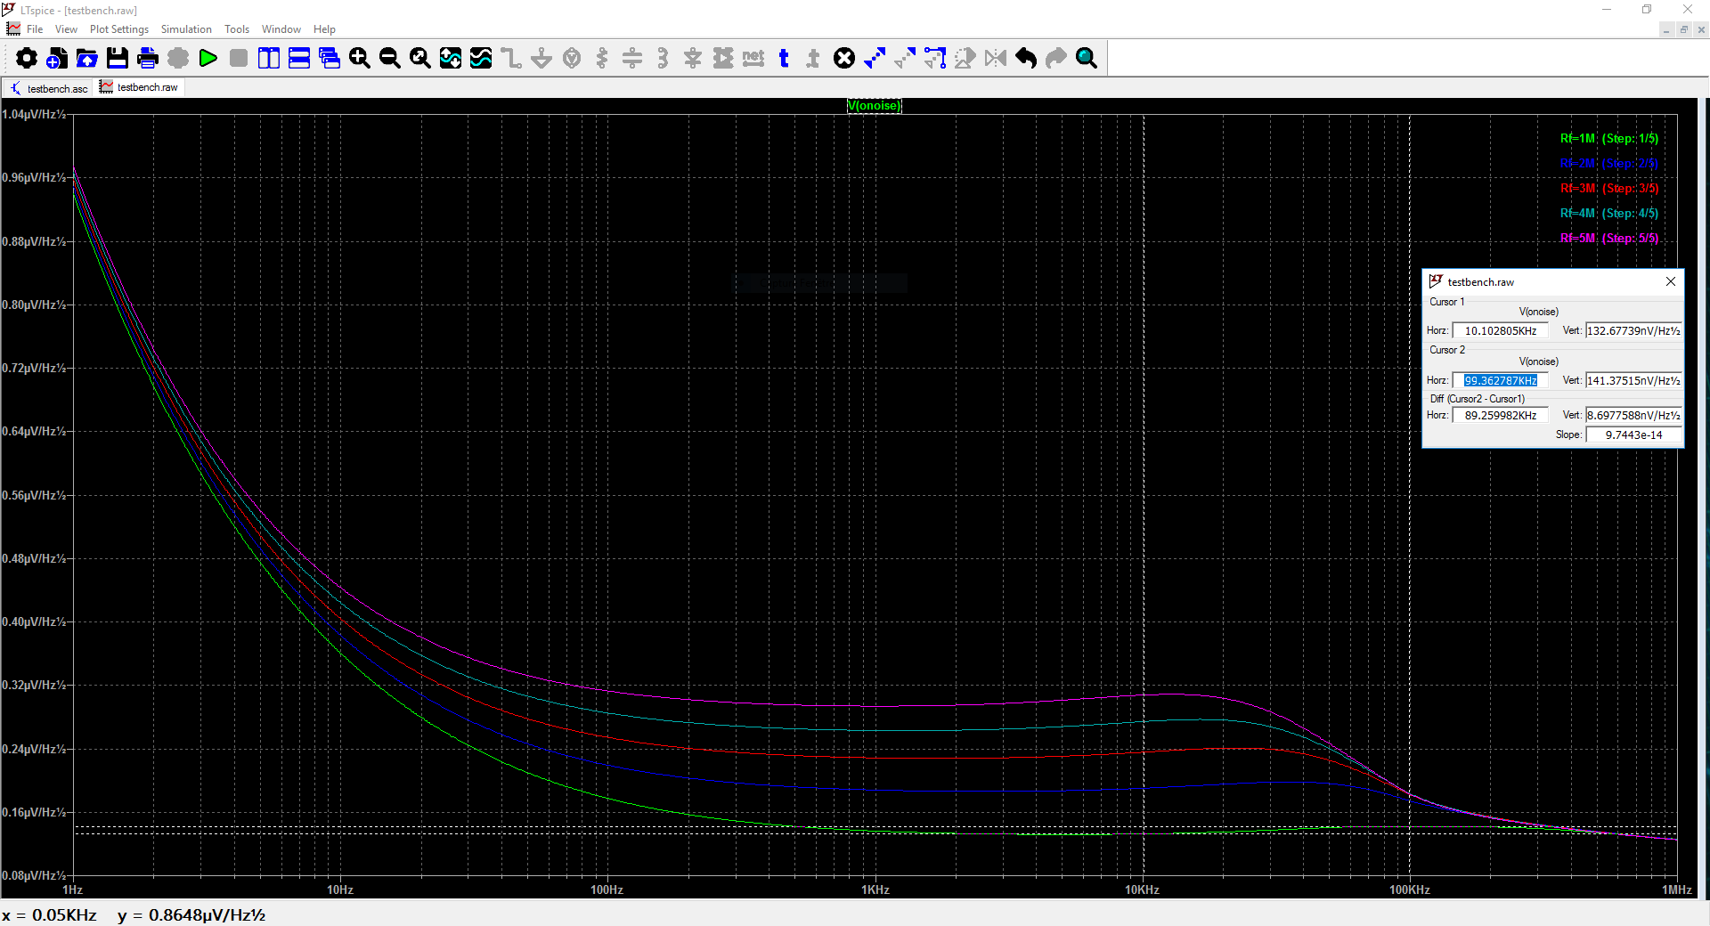

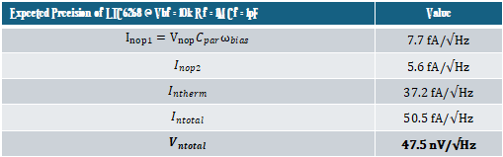
TIA Stage – LTSpice – (.noise) VRf Sweep
Expected Precision of LTC6268 @ Vbf = 10k Rf = 1M Cf = 1pF | Value
$$I_{nop1}=V_{nop}{C_{par}ω}_{bias}$$ | $$\text{7}\text{.7} \text{f}\text{A}\text{/√}\text{Hz}$$
$$I_{nop2}$$ | $$\text{5.6} \text{f}\text{A}\text{/√}\text{Hz}$$
$$I_{ntherm}$$ | $$\text{37.2} \text{f}\text{A}\text{/√}\text{Hz}$$
$$I_{ntotal}$$ | $$\text{50.5} \text{f}\text{A}\text{/√}\text{Hz}$$
$$V_{ntotal}$$ | $$\text{47.5} \text{nV}\text{/√}\text{Hz}$$
Sanity Check! $V_{ntotal}≈\text{132} \text{nV}\text{/√}\text{Hz}$
Seeing 3x contribution to noise at output
@ Rf is 1Meg, noise is all lower at 10k than the 100KHz operating frequency!
Notes:
Lower noise because of lower gain at the output
Though we expected lower current noise due to the resistor the gain contributes most to the output noise

Slide 15
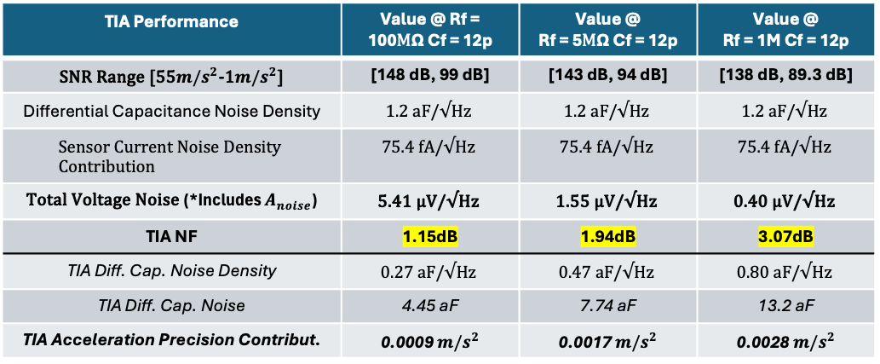
TIA Performance
$$X$$
$$I$$
$$V$$
$$A_{x}$$
$$−\frac{M}{K}$$
$$\frac{∂C}{∂X}×jω×V_{b}$$
$$−\frac{R_{f}}{1+jC_{f}R_{f}ω}$$
Acceleration noise
(thermal)
Current noise
(thermal, shot, flicker)
Quantizer noise
TIA Performance | Value @ Rf = 100$M\text{Ω}$ Cf = 12p | Value @ Rf = 5$M\text{Ω}$ Cf = 12p | Value @ Rf = 1M Cf = 12p
SNR Range [55$m/s^{2}$-1$m/s^{2}$] | [148 dB, 99 dB] | [143 dB, 94 dB] | [138 dB, 89.3 dB]
Differential Capacitance Noise Density | $$\text{1.2} \text{aF}\text{/√}\text{Hz}$$ | $$\text{1.2} \text{aF}\text{/√}\text{Hz}$$ | $$\text{1.2} \text{aF}\text{/√}\text{Hz}$$
$$\text{Sensor} \text{Current} \text{Noise} \text{Density} \text{Contribution}$$ | $$\text{75.4} \text{f}\text{A}\text{/√}\text{Hz}$$ | $$\text{75.4} \text{f}\text{A}\text{/√}\text{Hz}$$ | $$\text{75.4} \text{f}\text{A}\text{/√}\text{Hz}$$
$\text{Total} \text{Voltage} \text{Noise}$(*Includes $A_{noise}$) | $$\text{5.41} \text{μV}\text{/√}\text{Hz}$$ | $$\text{1.55} \text{μV}\text{/√}\text{Hz}$$ | $$\text{0.4}\text{0} \text{μV}\text{/√}\text{Hz}$$
TIA NF | 1.15dB | 1.94dB | 3.07dB
TIA Diff. Cap. Noise Density | $$\text{0.27} \text{aF}\text{/√}\text{Hz}$$ | $$\text{0.47} \text{aF}\text{/√}\text{Hz}$$ | $$\text{0.80} \text{aF}\text{/√}\text{Hz}$$
TIA Diff. Cap. Noise | 4.45 aF | 7.74 aF | 13.2 aF
TIA Acceleration Precision Contribut. | 0.0009 $m/s^{2}$ | 0.0017 $m/s^{2}$ | 0.0028 $m/s^{2}$
Convert Sensor noise to noise at the
Output of TIA
Even though the output noise is higher at the output the SNR is best at the highest gain possible
Precision of the system including
The sensor and the TIA together.

Slide 16
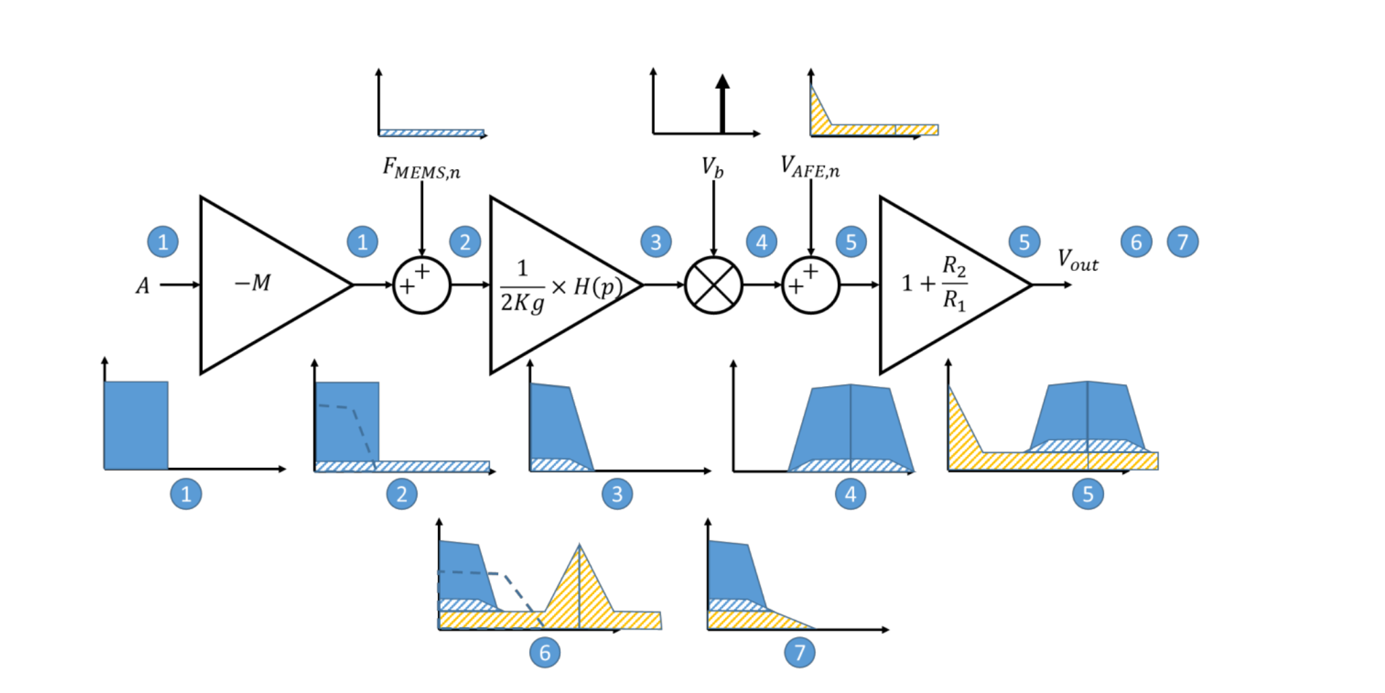
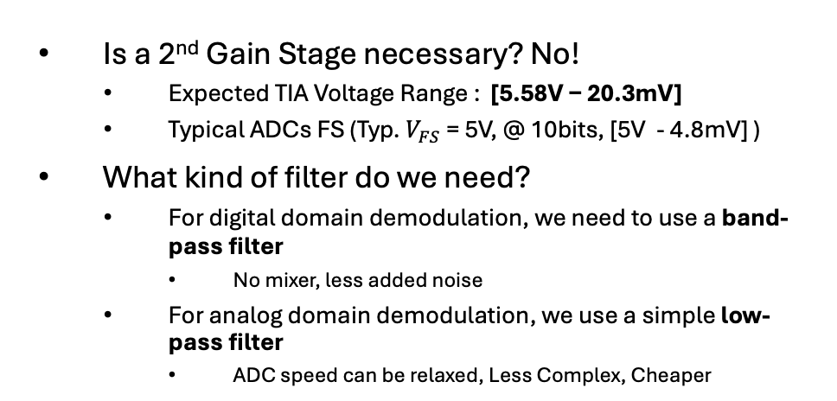
Post-TIA Process
Output of TIA used in acquisition chain
BandPass Anti-Aliasing for Digital Domain Demodulation
Is a 2nd Gain Stage necessary? No!
Expected TIA Voltage Range : [5.58V$\text{−}\text{ 20.3}\text{mV}\text{]}$
Typical ADCs FS (Typ. $V_{FS}$ = 5V, @ 10bits, [5V - 4.8mV] )
What kind of filter do we need?
For digital domain demodulation, we need to use a band-pass filter
No mixer, less added noise
For analog domain demodulation, we use a simple low-pass filter
ADC speed can be relaxed, Less Complex, Cheaper
What kind of ADC?
Most ADCs work for 10 kHz - 1 MHz (We need 20kHz)
With our SNR, we can achieve: ENOB = 17 bits
For low power, SAR is suitable
Suggest - Linear Technology LTC2386-18 (18 bit ADC)
We prefer RC low pass filter over LC circuits since the operating frequency is low, suitable for RC.
We suggest a Sallen-key circuit.
https://www.analog.com/media/en/technical-documentation/data-sheets/238618f.pdf
Notes:
Rest of the stages of the acquisition chain – A 2nd amplifier necessary? An Anti-Aliasing Filter? AD Converter? Assuming the fbias is demodulated digitally
Now what are the benefits of demodulating in analog
The TIA also acts as an LNA in a TX/RX chain thanks to Friis Eq. it should have extra low noise to reduce the noise factor up until the ADC
We prefer RC low pass filter over LC circuits since the operating frequency is low, suitable for RC.
For better performance, we suggest a sallen-Key circuit: les noise and sharper roll-off

Slide 17
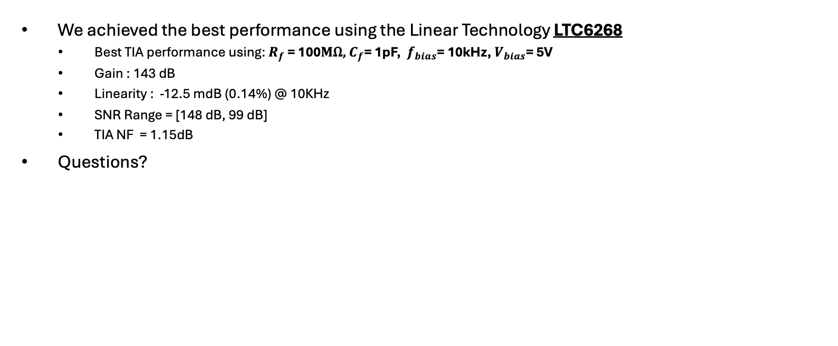
Conclusion
We achieved the best performance using the Linear Technology LTC6268
Best TIA performance using: $R_{f}$ = 100$M\text{Ω}\text{,}$ $C_{f}$= 1pF, $f_{bias}$= 10kHz, $V_{bias}$= 5V
Gain : 143 dB
Linearity : -12.5 mdB (0.14%) @ 10KHz
SNR Range = [148 dB, 99 dB]
TIA NF = 1.15dB
Questions?

